Slide 1
IMPACT OF
DRY EYE DISEASE IN PARAMEDICAL STUDENTS
BY PUJAYEETA BAIDYA
MOPTM 1st SEM, ROLL : 234306001
TRIPURA INSITUTE OF PARAMEDICAL SCIENCES

Slide 2
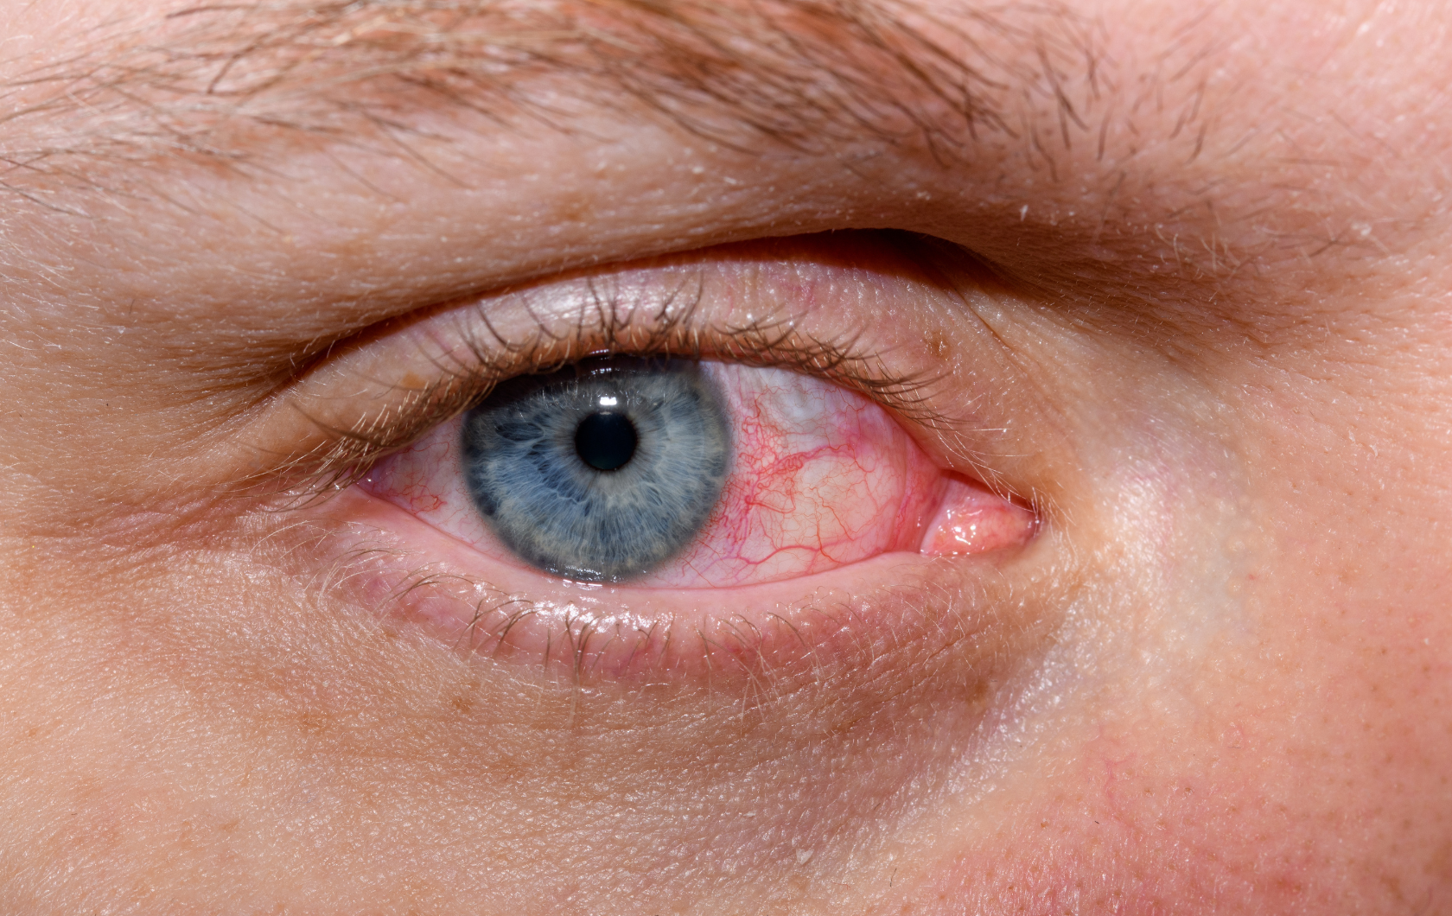
INTRODUCTION OF DRY EYE
Dry eye is recognized as a disturbance of the Lacrimal Functional Unit (LFU), an integrated system comprising the lacrimal glands, ocular surface (cornea, conjunctiva and Meibomian glands) and lids, and the sensory and motor nerves that connect them.
This functional unit controls the major components of the tear film and responds to environmental,
> Endocrinological and cortical influences.
Its overall function is to preserve the integrity of the tear film,
Transparency of the cornea, quality of the image projected onto the retina

Slide 3
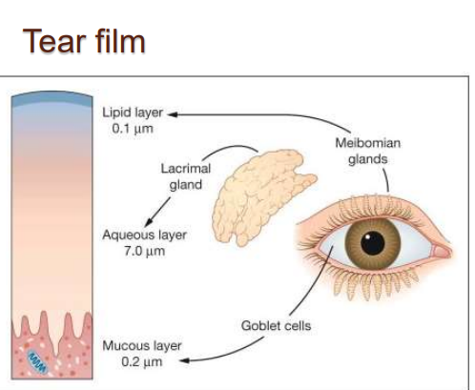
LIPID LAYER
0.1 µm
Meibomian Gland
Lacrimal
gland
Aqueous Layer 7.0 µm
Goblet Cells
Mucous Layer 0.2 µm

Slide 4
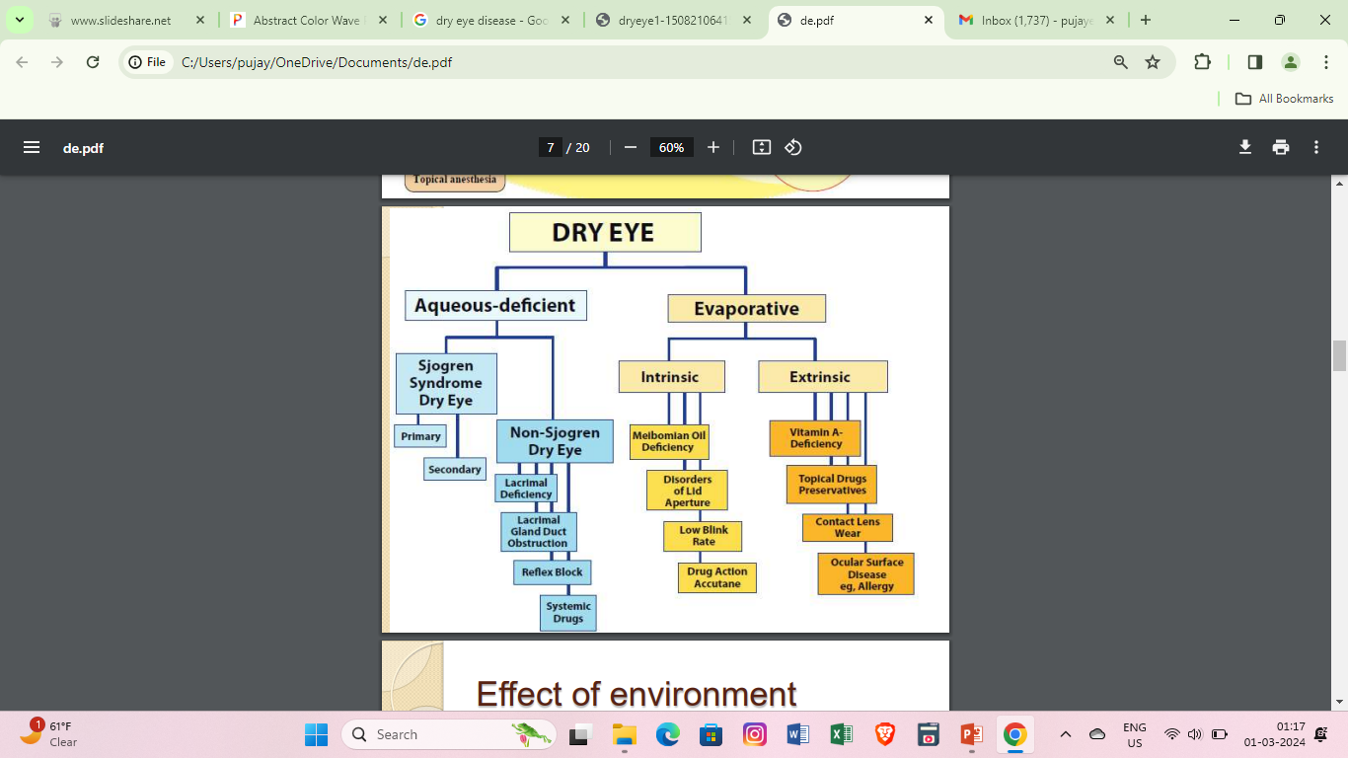
CLASSIFICATION OF DRY EYE

Slide 5
AQUEOUS TEAR-DEFICIENT DRY EYE (TEAR DEFICIENT DRY EYE; LACRIMAL TEAR DEFICIENCY)
It is an exocrinopathy in which the lacrimal and salivary glands are targeted by an autoimmune process.
The lacrimal and salivary glands are infiltrated by activated T-cells, which cause acinar and ductular cell death and hyposecretion of the tears or saliva.
Inflammatory activation within the glands leads to the expression of autoantigens at the surface of epithelial cells.

Slide 6
SJOGRENS SYNDROME
2 TYPES
PRIMARY SS
Primary Sjogren syndrome is a condition in which dry eyes and dry mouth result from lymphocytic infiltration of lacrimal gland and salivary gland.
SECONDARY SS
Consists of the features of primary sjogren syndrome together with the features
of an overt autoimmune connective
disease, such as rheumatoid arthritis, SLE.

Slide 7
NON SJOGREN SYNDROME DRY EYE
PRIMARY LACRIMAL GLAND DEFICIENCIES
SECONDARY LACRIMAL GLAND DEFICIENCIES
Age-related dry eye
Congenital alacrima
Familial dysautonomia
Lacrimal gland infiltration
Sarcoidosis
Lymphoma
AIDS
Lacrimal gland ablation Lacrimal gland denervation

Slide 8
EVOPERATIVE DRY EYE
INTRINSIC CAUSES :
MGD
DISORDERS OF LID APERTURE
LOW BLINK RATE
EXTRINSIC CAUSES :
OCCULAR SURFACE DISORDERS VITAMIN A DEFICIENCY TOPICAL DRUGS AND PRESERVATIVES ALLERGIC CONJUNCTIVITIS

Slide 9
CAUSES OF DRY EYE
Dry eyes are caused by a variety of reasons that disrupt the healthy tear film. Your tear film has three layers: fatty oils, aqueous fluid and mucus. This combination usually keeps the surface of your eyes lubricated, smooth and clear. Problems with any of these layers can cause dry eyes.
Reasons for tear film dysfunction are many, including hormone changes, autoimmune disease, inflamed eyelid glands or allergic eye disease. For some people, the cause of dry eyes is decreased tear production or increased tear evaporation.

Slide 10
CAUSES OF DRY EYE CONT…
TEAR GLANDS AND TEAR DUCTS
The tear glands located above each eyeball, called the lacrimal glands, continuously supply tear fluid that's wiped across the surface of your eye each time you blink your eyelids. Excess fluid drains through the tear ducts into the nose.
Decreased tear production
Dry eyes can occur when you're unable to produce enough liquid tears, also called aqueous fluid. The medical term for this condition is keratoconjunctivitis sicca.

Slide 11
CAUSES OF DRY EYE CONT…
Common causes of decreased tear production include:
• Aging
• Certain medical conditions including Sjogren's syndrome, allergic eye disease, rheumatoid arthritis, lupus, scleroderma, graft vs. host disease, sarcoidosis, thyroid disorders or vitamin A deficiency
• Certain medicines, including antihistamines, decongestants, hormone replacement therapy, antidepressants, and medicines for high blood pressure, acne, birth control and Parkinson's disease
• Corneal nerve desensitivity caused by contact lens use, nerve damage or laser eye surgery, though symptoms of dry eyes related to this procedure are usually temporary.
Increased tear evaporation
The oil film produced by small glands on the edge of your eyelids (Meibomian glands) might become clogged. Blocked Meibomian glands are more common in people with rosacea or other skin disorders.

Slide 12
CAUSES OF DRY EYE CONT…
Common causes of increased tear evaporation include:
• Posterior blepharitis (Meibomian gland dysfunction)
• Blinking less often, which tends to occur with certain conditions, such as Parkinson's disease; or when you're concentrating during certain activities, such as while reading, driving or working at a computer
• Eyelid problems, such as the lids turning outward (ectropion) and the lids turning inward (entropion)
• Eye allergies
• Preservatives in topical eye drops
• Wind, smoke or dry air
• Vitamin A deficiency.

Slide 13
SIGNS & SYMPTOMS OF DRY EYE
1. A stinging, burning or scratchy sensation in your eyes
2. Stringy mucus in or around your eyes
3. Sensitivity to light
4. Eye redness
5. A sensation of having something in your eyes
6. Difficulty wearing contact lenses
7. Difficulty with night-time driving
8. Watery eyes, which is the body's response to the irritation of dry eyes
9. Blurred vision or eye fatigue.

Slide 14
MANAGEMENT
A. Tear supplementation: lubricants
B. Tear Retention
C. Tear stimulation
D. Biological tear substitutes
E. Anti-inflammatory therapy
F. Essential fatty acids
G. Environmental strategies
H. Using artificial tear to lubricate the eye.
I. Surgical procedure- Punctal plug is used to treat dry eyes.
J. Using bandage contact lens to treat dry eyes.
K. Avoid smoking
L. Take breaks during long task
M.Taking adequate amount of food containing vitamin

Slide 15
R E S U L T
TABLE 1
Gender | STUDENTS | PERCENTAGE
BOY | 51 | 37.7
GIRL | 84 | 62.2
TOTAL | 135 | 100

Slide 16
TABLE 2
Complication | Boys |  | % |  | Girls |  | %
 | Yes | No | Yes | No | Yes | No | Yes | No
Burning sensation | 15 | 36 | 29.4 | 70.5 | 30 | 54 | 35.7 | 64.2

Slide 17
TABLE 3
Complication | Boys |  | % |  | Girls |  | %
 | Yes | No | Yes | No | Yes | No | Yes | No
Irritation | 18 | 33 | 35.2 | 64.7 | 45 | 39 | 53.5 | 46.4

Slide 18
TABLE 4
Complication | Boys |  | % |  | Girls |  | %
 | Yes | No | Yes | No | Yes | No | Yes | No
Foreign body sensation | 33 | 18 | 64.7 | 35.2 | 33 | 51 | 39.2 | 60.7

Slide 19
TABLE 5
Complication | Boys |  | % |  | Girls |  | %
 | Yes | No | Yes | No | Yes | No | Yes | No
Redness | 21 | 30 | 41.1 | 58.8 | 30 | 54 | 35.7 | 64.2

Slide 20
TABLE 6
 | >5mm | 5 to 10 mm | <10mm
BOYS | 07 | 34 | 10
GIRLS | 20 | 50 | 14

Slide 21
DISCUSSION
Discussion may highlight the prevalence of dry eye among paramedical college students, emphasizing that it is a significant issue affecting a notable portion of the student population. The data might provide insights into the factors contributing to the development of dry eye, such as prolonged screen time or lack of proper eye care practices.
The discussion could delve into the potential consequences of dry eye on the academic performance, well-being, and overall quality of life of these students. The data might reveal the extent to which dry eye symptoms impact their daily activities and productivity.
Furthermore, the discussion might explore existing treatments and preventive measures for dry eye, assessing their effectiveness and relevance to the paramedical college student population. The data might highlight any specific recommendations or interventions that have been found to be beneficial in managing and reducing dry eye symptoms.

Slide 22
CONCLUSION
The project may summarize the key findings from the data analysis and emphasize the need for attention and action regarding dry eye among paramedical college students. It may stress the importance of implementing strategies to raise awareness about dry eye, promote eye health practices, and provide appropriate support and resources for affected students.
Common eye diseases, including visual abnormalities, are caused by the interaction of human genes and the increasing of the number of DED patients have increased by the dramatically of the past decades. The increasing of visual tasks, an aging society, sleep deprivation, lack of exercise, increasing in obesity and sedentary lifestyles could also contribute to the increase in DED incidence.

Slide 23
CONCLUSION
The DED treatment recommendations were based on the modified severity grading.
1" stage- Education and counselling, environmental management, elimination of offending systemic medications, allergy eye drops.
2nd stage- If stage 1 treatments are inadequate, add: Unpreserved tears, gels, ointments, Nutritional supplements, Secretagogues.
In one sense, DED can be considered lifestyle diseases. It is very important to make sure that, the eyes must be checked often by any optometrists at least once in a month. When using digital screens give your eyes a break. Use the 20-20-20 rule (every 20 minutes, take a 20 second break and focus your eyes on something at least 20 feet away). Eat green leafy vegetables.
Avoid sunlight, for that use sunglasses. Use protective ARC glasses for computer works. Avoid using mobile phones in dark room. Drink sufficient water.
The purpose of this paper was a global consensus among optometrists/ ophthalmologists who examine DED patients almost every day.

Slide 24
THANK YOU
PUJAYEETA BAIDYA, 1ST SEM - TIPS

